Slide 1

Notes:
Welcome & Introduction: Good morning/afternoon, everyone. Today, we are going to dive into the core principles of evidence-based investing, risk management, and market history. The insights we'll discuss today are synthesized directly from Dr. William Bernstein—a former practicing neurologist turned world-renowned investment advisor and author of foundational classics like The Four Pillars of Investing and The Intelligent Asset Allocator.
Setting the Scene: Notice the title: 'I've Seen This Market Before: Timeless Wisdom on Risk, Bubbles, and Winning the Game.' Looking back at financial history—whether it’s 1982, 1999, or 2007—market sentiment tends to follow predictable human psychological loops. When markets reach elevated levels, investors routinely convince themselves that 'this time is different' due to novel technological revolutions.
Core Philosophy: Throughout this deck, we will examine how market hubris manifests today, why mechanical valuation metrics like the Shiller CAPE ratio are dangerous if misused for market timing, and how we must redefine 'risk' away from short-term market fluctuations and toward the actual catastrophic risk of running out of money in old age. Let's step through these principles to see how we can build an ironclad strategy.
I’ve Seen This Market Before — William Bernstein
https://www.youtube.com/watch?v=Eu_NV9nR1uY

Slide 2

Notes:
Historical Parallels (1999 vs. Today): If you look at the market sentiment today, it bears an uncanny resemblance to the late 1990s dot-com era. Back in 1999, there was overwhelming exuberance around a game-changing technology—the Internet. Today, it’s Artificial Intelligence. In both eras, you hear investors bragging at dinner parties about being 100% in equities while claiming 'bonds are for dummies'. Dr. Bernstein points out that nobody brags about being 100% equities during market bottoms like 1982 or 2008—only at cycle tops.
AI Bubble Assessment: Dr. Bernstein notes that when something 'walks like a duck, quacks like a duck, and looks like a duck,' it usually is a duck. He estimates a 20% to 30% probability that we are currently inside a dot-com style AI bubble. While true technological revolutions transform society, history shows from the 19th-century UK railway manias to the 1990s internet boom that investors routinely overpay for that growth in the short to medium term.
Institutional Forecast Swings: A perfect illustration of current market hubris is institutional behavior. Vanguard's Capital Market Model recently raised its 10-year annualized return forecast for US equities from ~1% up to ~6%, almost entirely driven by assumptions surrounding the AI buildout. Dr. Bernstein expressed stark skepticism toward such abrupt institutional forecast shifts. Changing long-term expected returns so drastically based on short-term corporate capital expenditure trends isn't a reliable forecasting method.
Takeaway: Do not let public euphoria dictate your asset allocation. Highly visible market optimism usually means that growth expectations are already fully priced into securities.

Slide 3
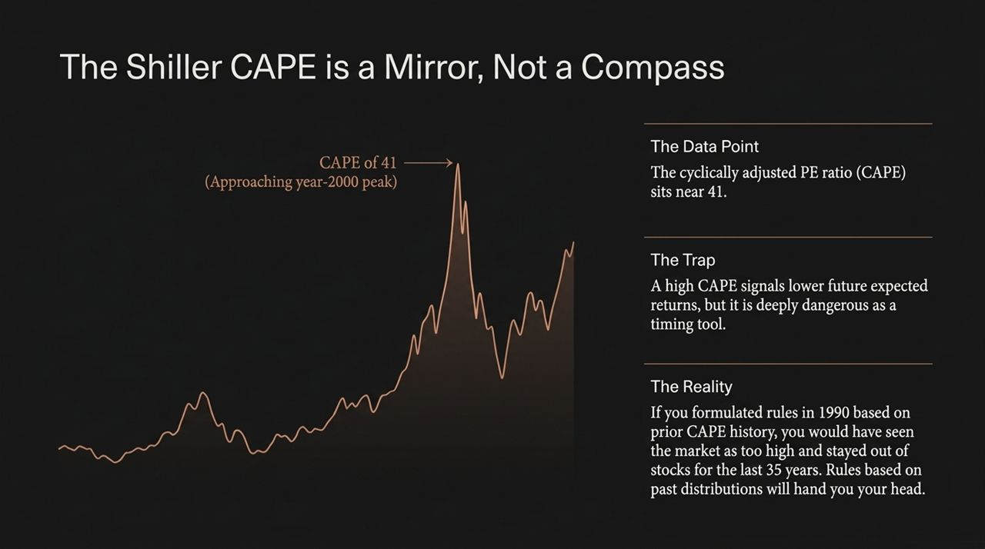
Notes:
Understanding the Metric: Slide 3 presents the Cyclically Adjusted Price-to-Earnings (CAPE) ratio, pioneered by Nobel laureate Robert Shiller. It measures the S&P 500 price relative to average 10-year real inflation-adjusted earnings. Currently, CAPE sits near 41—a valuation level seen only near the peak of the 2000 tech bubble.
The High Valuation Trap: Mathematically, a CAPE of 41 signals that future long-term expected returns from equities will likely be muted compared to historical averages. However, here lies the critical trap: the CAPE ratio is a terrible market timing tool.
Why Past Rules Fail (Non-Stationarity): In econometrics, market distributions are non-stationary—meaning future return distributions do not rigidly obey past statistical boundaries. If an investor in 1990 looked back at historical CAPE averages and set a rule to exit stocks whenever CAPE exceeded historical norms, that investor would have stayed out of the market for the last 35 years! They would have missed one of the greatest wealth-creation periods in human history.
Key Lesson: Use CAPE as a mirror to understand where market expectations currently stand, but never use it as a compass or trigger to jump in and out of stocks. Abandoning equities entirely because of a CAPE of 41 is a classic mistake that hands your portfolio's yield over to cash while missing long-term compounding.

Slide 4
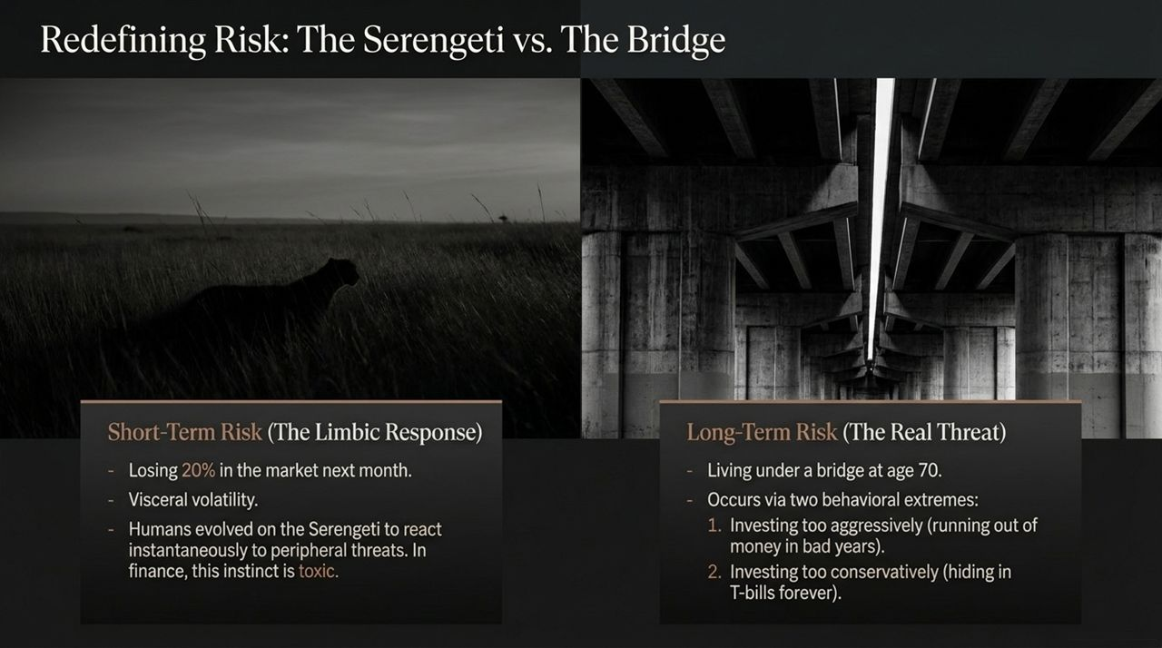
Notes:
Neurological Origins of Short-Term Risk: To invest successfully, we must fundamentally redefine what 'risk' means. As humans, our brains evolved on the Serengeti plains in East Africa. When our ancestors saw a predator or heard a snake hiss, their limbic system fired instantaneously to protect them. In finance, this translates into visceral panic when the market drops 20% in a month. We experience short-term volatility as an immediate life-or-death threat.
The Real Risk (Long-Term Destitution): However, short-term price fluctuations are not real financial risk. The true, catastrophic risk in personal finance is living under a bridge at age 70 because you ran out of money.
The Two Behavioral Extremes: Dr. Bernstein points out that investors wind up under a bridge via two opposing behavioral blunders:
Investing too aggressively: Taking excessive equity risk right before retirement, suffering a severe market drawdown, and being forced to liquidate depreciated assets to fund daily living expenses (sequence-of-returns risk).
Investing too conservatively: Hiding in short-term T-bills or cash out of fear of market drops. Over 20–40 years, inflation slowly decimates their purchasing power, leaving them impoverished in old age.
Key Lesson: A balanced portfolio isn't built to eliminate monthly volatility; it's designed to insulate you from long-term destitution.

Slide 5

Notes:
The Core Premise: Slide 5 highlights Dr. Bernstein’s most famous financial directive: 'If you've won the game, stop playing.' The purpose of investing is not to maximize yields or beat your neighbor's portfolio returns; it is to minimize your probability of dying poor.
Liability Matching (Defeasing Expenses): Once you have accumulated enough wealth to guarantee your basic retirement living needs—rent, healthcare, groceries—you should take those core needs off the table entirely. This is known as defeasing your liabilities.
3-Step Practical Framework:
Step 1: Calculate Residual Spending Gap: Identify basic essential annual expenses and subtract non-portfolio guaranteed income. For example, if you need $70,000/year to live and receive $30,000 from Social Security, your residual spending gap is $40,000 per year.
Step 2: Multiply by Expected Duration: Multiply this $40,000 gap by your estimated retirement horizon (e.g., 25 years). $40,000 × 25 = $1,000,000.
Step 3: Construct a TIPS Ladder: Take that $1,000,000 and invest it directly into a Treasury Inflation-Protected Securities (TIPS) ladder. Each annual rung matures to deliver the exact real inflation-adjusted cash flow required for that year's living expenses.
Conclusion: By locking in basic survival needs with a risk-free TIPS ladder, market crashes no longer threaten your housing or food security. Any remaining assets can stay in equities for legacy or discretionary spending.

Slide 6

Notes:
TIPS Execution Dynamics: Executing a TIPS ladder in the secondary market requires understanding bond mechanics. Today, TIPS offer real yields around 3%—unusually high historically. However, investors must be cautious when buying older TIPS in secondary markets. An older bond selling at a apparent price discount of 90 cents on the dollar might actually cost $1,500 per $1,000 face value because of its accrued principal inflation index factor over its 10- or 15-year life.
Cash Reserves & T-Bills: For liquid emergency funds or near-term spending, short-term Treasury Bills (T-Bills) are unmatched. They are exempt from state and local income taxes, offer instant liquidity, and can be automatically rolled at brokerage firms (like Fidelity) to construct a zero-expense-ratio cash management vehicle.
The Municipal Bond Trap: Slide 6 warns against holding Municipal bonds for emergency or safe cash reserves. During severe liquidity panics (such as 2008), municipal bond prices can plummet by 10% to 20% due to market illiquidity and credit risk fears. Do not let small state-tax advantages compromise the safety of your primary safety net.

Slide 7
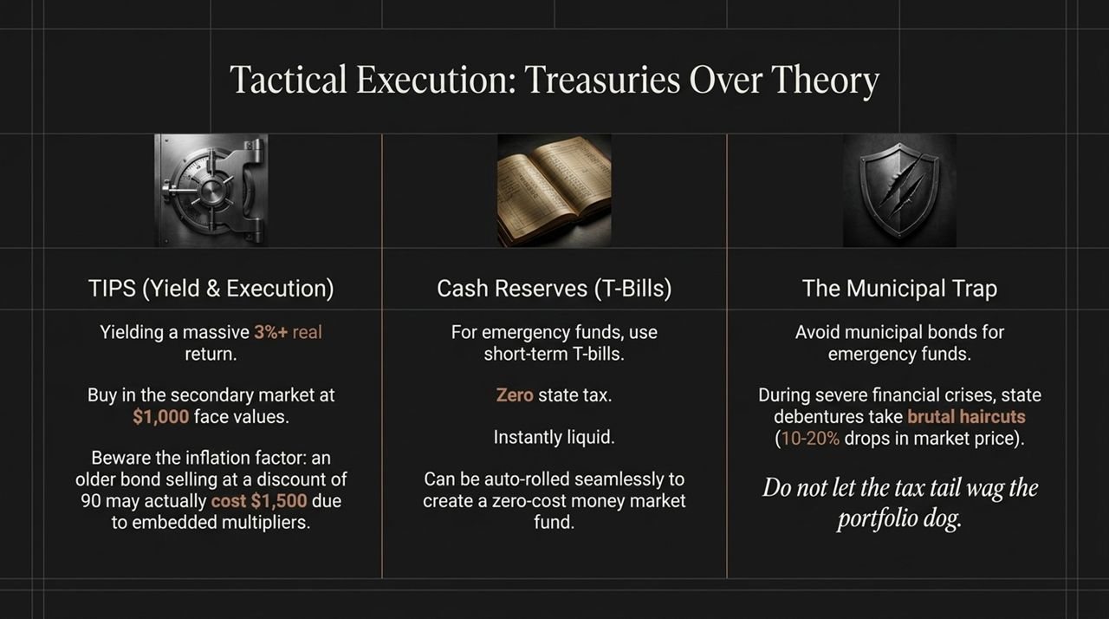
Notes:
Commodities (Futures vs. Producers): Many investors buy commodity futures funds expecting an inflation hedge. In reality, holding futures contracts incurs a negative roll return (~5% loss annually) because financial institutions bid up future contracts (contango). If you desire commodity exposure, invest in commodity-producing companies (oil/mining firms) rather than futures contracts.
Value & Factor Investing: Financial theory suggests small-cap value stocks earn a premium due to higher risk. In practice, factor strategies have underperformed standard broad market indices for the past 15 years. Tilting heavily into value requires tremendous psychological fortitude. For 99% of investors, chasing factor tilts leads to selling low out of frustration.
Momentum Strategies: Momentum strategies aim to buy recent winners and sell losers. However, extreme turnover, trading costs, and rapid factor crashes make executing true momentum strategies almost impossible for individual retail investors trading on a laptop.
Summary: For the vast majority of people, low-cost total market index funds outperform complex alternative asset strategies once real-world friction and behavior are accounted for.

Slide 8
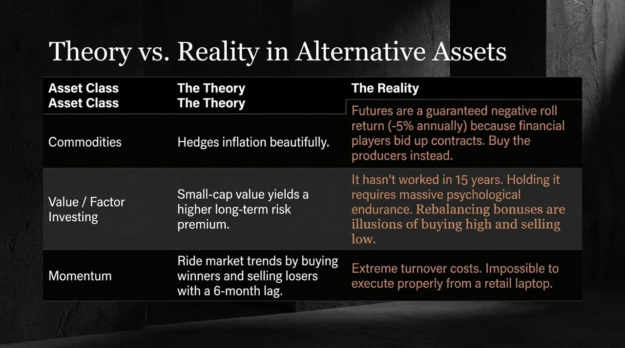
Notes:
The Academic Ideal: Modern Portfolio Theory shows that by plotting expected returns against standard deviation, you can locate the 'Efficient Frontier'—the optimal portfolio (like a 60/40 mix) offering the maximum Sharpe ratio. Academic finance teaches that to achieve higher returns, you should take that optimal 60/40 portfolio and leverage it up using borrowed funds along a tangent line.
Real-World Failure: In the real world, finance is not physics! You cannot predict future correlation and variance matrices based on past data. Optimizing portfolios strictly off historical data produces terrible out-of-sample forward results.
Practical Takeaway: Attempting to run a leveraged academic portfolio exposes you to catastrophic margin calls during market shocks. Naive, simple asset allocations (such as plain indexing) consistently beat complex backtested models in practice.

Slide 9
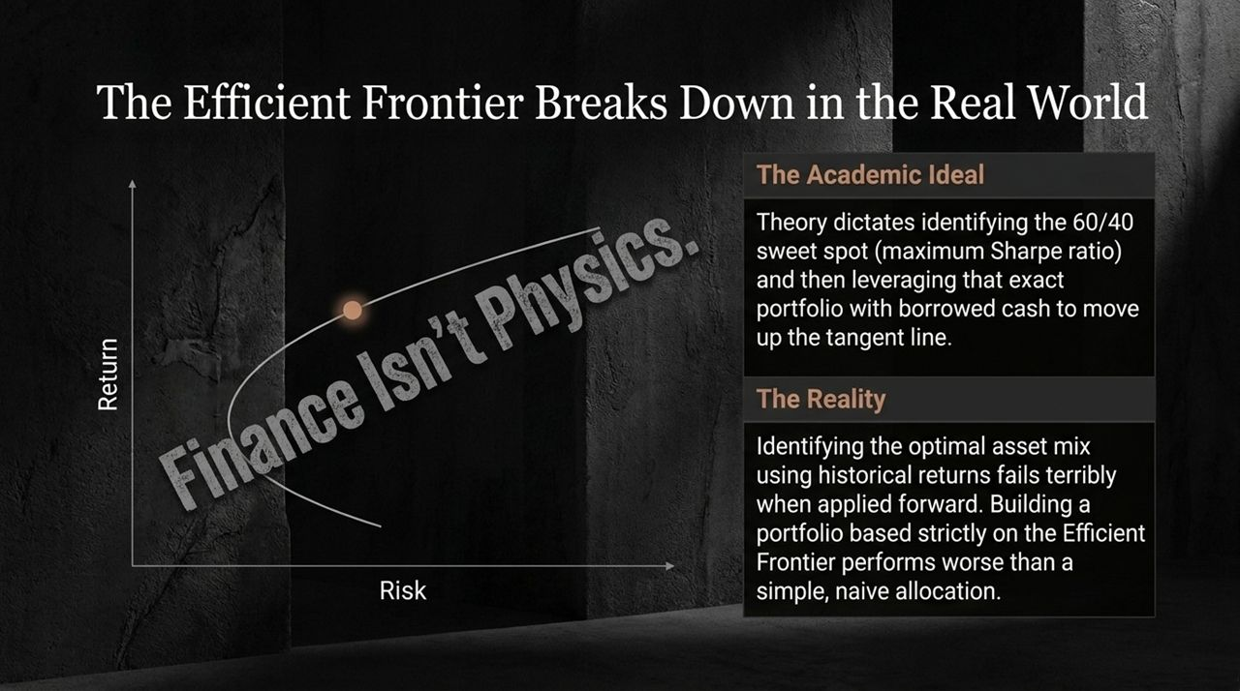
Notes:
The Cautionary Tale of LTCM: Slide 9 highlights Long-Term Capital Management (LTCM) in 1998. LTCM’s leadership included two Nobel Prize winners and top quantitative minds. Their mathematical models were flawless on paper, yet they over-leveraged their positions and nearly crashed the global financial system during the Russian default crisis.
IQ vs. Emotional Discipline: Finance is not a domain where an IQ of 160 automatically triumphs over an IQ of 130. As Warren Buffett famously noted, investing success relies on discipline and emotional control. The winning investor is simply the one who can master their limbic system during times of extreme panic or greed.

Slide 10

Notes:
Professional Rigor in Finance: Dr. Bernstein emphasizes that you wouldn't practice medicine by reading USA Today. Likewise, you shouldn't manage your life savings based on Wall Street Journal headlines or cable news.
The Four Essential Pillars:
Theory of Finance: Understanding basic academic principles, risk premiums, and discounting—while respecting their real-world boundaries.
History of Investing: Studying past market manias, panics, secular cycles, and statistical distributions.
Psychology of Investing: Recognizing human behavioral traps, cognitive biases, and limbic fear responses.
Business of Investing: Understanding the financial industry's fee structures, conflict of interests, and execution costs.
The Golden Rule: If a piece of market news is on a major front-page headline, it is already impounded into security prices. Ignore the noise, manage your emotions, defease your essential liabilities, and give your long-term strategy time to ripen.

Slide 11

Notes:
Visual Theme: Slide 11 contrasts the dark, isolated reality of financial ruin with structural asset protection.
Addressing Investor Anxiety: When market headlines scream about interest rate hikes or recessions, investors often feel overwhelmed and retreat into safe-haven cash. However, hiding in cash long-term introduces the silent threat of purchasing power loss.
Connecting to Strategy: By separating short-term market noise from your long-term plan, you protect both your emotional well-being and your financial security.

Slide 12

Notes:
Emotional State in Investing: Slide 12 illustrates the contrast between emotional panic and disciplined execution. The figure on the right represents an investor trying to trade every Fed rate move and market headline.
Achieving Investment Serenity: The figure on the left represents an investor who has built a defeased TIPS ladder for basic living needs and holds broad index funds for growth. Calmness in investing comes from robust structural planning rather than market timing.

Slide 13
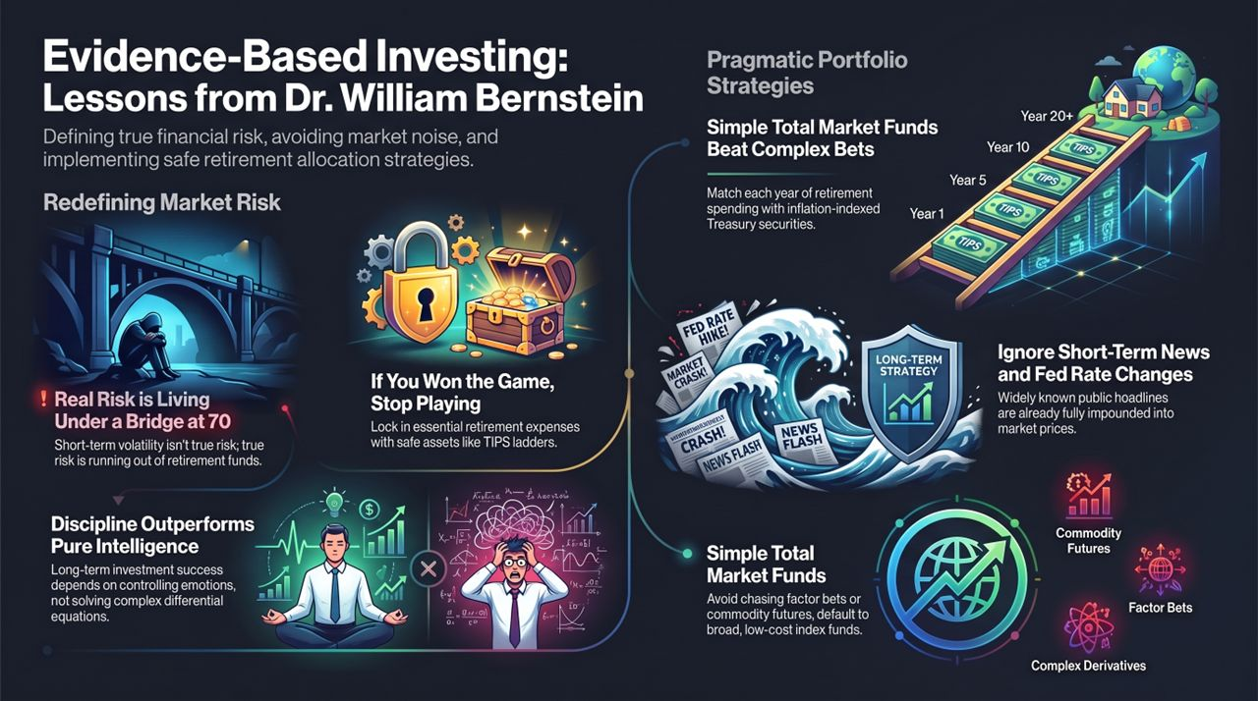
Notes:
Recap of Core Takeaways:
Redefine Risk: Focus on preventing long-term shortfall in retirement rather than managing short-term monthly volatility.
Stop Playing When You've Won: Secure essential retirement expenses through a TIPS ladder.
Keep Allocations Simple: Low-cost broad market index funds reliably beat complex factor tilts and commodity futures.
Ignore Daily News: Public headlines are already priced in.
Closing Thought: By controlling your limbic system, matching liabilities with inflation-indexed Treasuries, and staying broad and low-cost in equities, you build a resilient financial plan designed to last.
I’ve Seen This Market Before — William Bernstein
https://www.youtube.com/watch?v=Eu_NV9nR1uY

